Slide 1

Sentiment classification of social media
Under Supervision of
Internal: Tannu
School of Engineering and Technology
Team Members: Karan Solanki (2401560063)
Sakshi Yadav(2401560072)
Tanishq (2401560020)

Slide 2
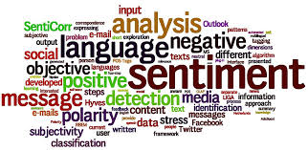
Problem Statement
Customer Feedback Monitoring
Develop a sentiment classifier to automatically analyze social media comments related to a specific brand or product, in order to help businesses monitor customer satisfaction and address negative feedback in real-time.
Political Sentiment Tracking
Create a model that classifies sentiments in tweets related to political events, politicians, or government policies, to assist in public opinion analysis and trend prediction during elections or national debates.
Crisis Management
Build a system to detect negative sentiments in real-time social media posts during natural disasters or emergencies, helping government agencies or NGOs to respond to public concerns quickly.
Entertainment Industry Monitoring
Design a sentiment analysis tool to assess public reaction to newly released movies, games, or songs on platforms like Twitter, Reddit, or YouTube.
Mental Health Indicator
Develop a sentiment classification model to identify potentially harmful or negative emotional posts, which could serve as a warning indicator for mental health support services.

Slide 3
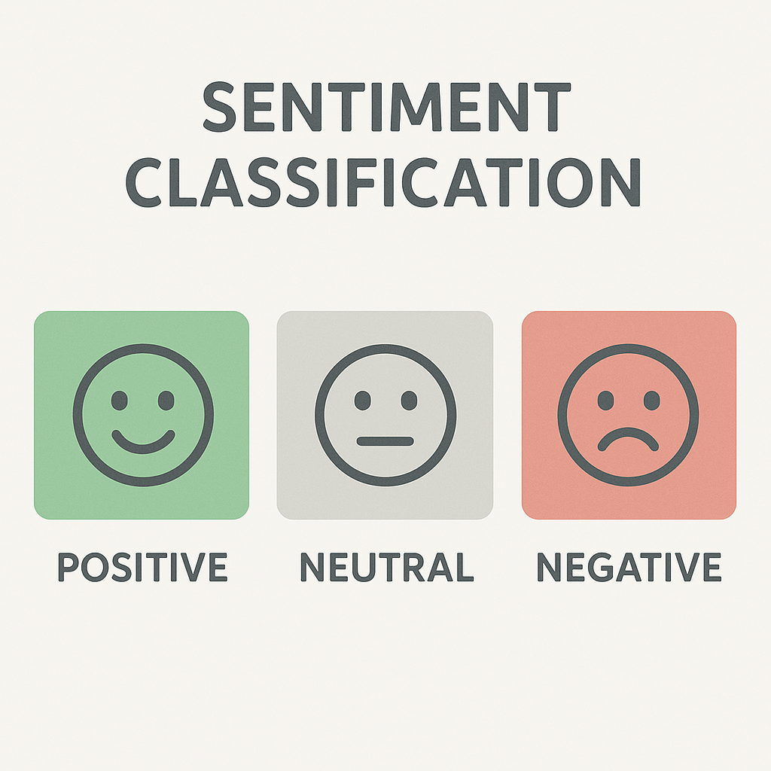
OBJECTIVES
To collect and prepare a dataset of social media posts (e.g., tweets, comments, captions) labeled with sentiment categories.
To preprocess the textual data by cleaning, tokenizing, removing stopwords, and normalizing the text for effective analysis.
To extract relevant features from the text using methods like Bag of Words or TF-IDF for machine learning model input.
To train and evaluate different machine learning algorithms (e.g., Naive Bayes, SVM, Logistic Regression) for classifying sentiment.
To compare model performance using metrics such as accuracy, precision, recall, and F1-score to determine the most effective approach.
To build a prediction function that allows sentiment classification of new, unseen social media text inputs.
To provide insights or visualizations that highlight overall sentiment trends from the classified data.

Slide 4
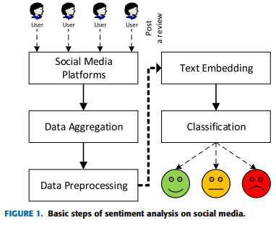
methodology

Slide 5
Key features of the project
Automated Sentiment Detection
Classifies social media text (e.g., tweets, comments) into Positive, Negative, or Neutral sentiment categories using machine learning.
Text Preprocessing Pipeline
Implements NLP techniques such as lowercasing, punctuation removal, stopword removal, and tokenization to clean and normalize text.
Customizable Dataset Input
Supports structured input in .csv format, allowing users to train the model on various domains like product reviews, political tweets, or public feedback.
Machine Learning Model Integration
Uses Naive Bayes classifier for fast and effective sentiment prediction. Easily extendable to other algorithms like SVM, Logistic Regression, or deep learning models.
Model Evaluation Tools
Provides accuracy score, confusion matrix, and detailed classification report (precision, recall, F1-score) for performance analysis.

Slide 6
Conclusion & Future work
Conclusion:
This project successfully demonstrated the development of a sentiment classification system for social media using basic natural language processing techniques and machine learning algorithms. By preprocessing raw social media text and training a classifier (such as Naive Bayes), the system could accurately categorize input text into positive, negative, or neutral sentiments. The solution is lightweight, scalable, and practical for real-world applications like brand monitoring, opinion mining, and crisis detection. Evaluation metrics showed acceptable accuracy, and the prediction pipeline handled new inputs effectively.
Future Work:
Use of Larger and More Diverse Datasets
Advanced Feature Extraction
Deep Learning Models
Multilingual Support

